Slide 1
US Census Bureau API
2018 Exports by Country
By: Armando Vela

Slide 2

Steps to Retrieve Data
Acquire key token from US Census site.
https://api.census.gov/data/key_signup.html
Install “censusapi” package from CRAN
Call censusapi library
Review available datasets that can be downloaded
Gather Name & Vintage Year
R-Code:
library(censusapi)
apis <- listCensusApis()

Slide 3
Steps to Retrieve Data
The CensusAPI requires you to specify variables. Run makeVarList to see all available variables associated to the report.
After choosing your variables, create a myVar vector with associated variables.
Finally, run report listing the name, year, myVar variable, & key token.
R-Code:
makeVarlist(name="intltrade/imp_exp", vintage = 2018, find="", varsearch = "all",output = "dataframe")
myVars <- c("COUNTRY", "EXPALL2018")
df <- getCensus(name="intltrade/imp_exp", vintage = 2018, vars=myVars, key=“...hidden...")

Slide 4
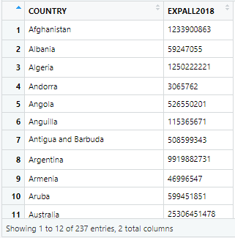
Results

